Slide 1
CPSC 503 Computational Linguistics
Encoder Decoder / Attention/ Transformers /
Lecture 15
Giuseppe Carenini
Slides Sources: Jurafsky & Martin 3rd Ed /
blog https://jalammar.github.io/illustrated-transformer/

Slide 2
Today Nov 4
Encoder Decoder
Attention
Transformers

Slide 3
Encoder-Decoder
RNN: input sequence is transformed into output sequence in a one-to-one fashion.
Goal: Develop an architecture capable of generating contextually appropriate, arbitrary length, output sequences
Applications:
Machine translation,
Summarization,
Question answering,
Dialogue modeling.
Notes:
that are capable of generating
contextually appropriate, arbitrary length, output sequences. Encoder-decoder networks
have been applied to a very wide range of applications including machine
translation, summarization, question answering, and dialogue modeling.

Slide 4

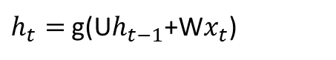



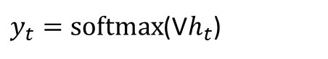

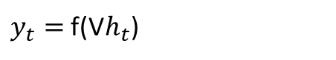

Simple recurrent neural network illustrated as a feed-forward network
Most significant change: new set of weights, U
connect the hidden layer from the previous time step to the current hidden layer.
determine how the network should make use of past context in calculating the output for the current input.
$y_{t}=softmax$(V$h_{t}$)
$y_{t}=$f(V$h_{t}$)
$h_{t}=$g(U$h_{t−1}$+W$x_{t}$)
Notes:
Simple recurrent neural network illustrated as a feed-forward network
The most significant change lies in the new set of weights,
U, that connect the hidden layer from the previous time step to the current hidden
layer. These weights determine how the network should make use of past context in
calculating the output for the current input.

Slide 5
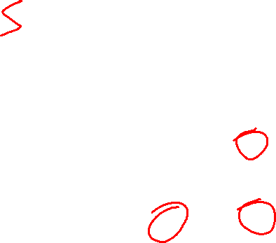
Simple-RNN abstraction
y₁
y₂
y₃
Notes:
In figures such as this, the
various layers of units are copied for each time step to illustrate that they will have
differing values over time. However the weights themselves are shared across the
various time steps. Finally, the fact that the computation at time t requires the value
of the hidden layer from time t-1 mandates an incremental inference algorithm that
proceeds from the start of the sequence to the end as shown in Fig. 9.5.

Slide 6
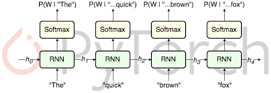
RNN Applications
Language Modeling
Sequence Classification (Sentiment, Topic)
Sequence to Sequence
Notes:
Simple recurrent networks have proven to be an effective approach to language modeling,
sequence labeling tasks such as part-of-speech tagging, as well as sequence
classification tasks such as sentiment analysis and topic classification. And as we’ll
see in Chapter 22, they form the basic building blocks for sequence to sequence
approaches to applications such as summarization and machine translation.

Slide 7
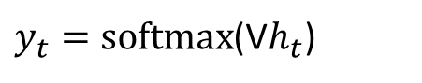
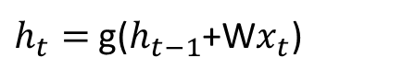
Sentence Completion using an RNN
$y_{t}=softmax$(V$h_{t}$)
$h_{t}=$g($h_{t−1}$+W$x_{t}$)
Trained Neural Language Model can be used to generate novel sequences
Or to complete a given sequence (until end of sentence token <\s> is generated)
Notes:
Given a trained model, we can ask the network to generate novel sequences by first randomly sampling
an appropriate word as the beginning of a sequence. We then condition the
generation of subsequent words on the hidden state from the previous time step as
well as the embedding for the word just generated, again sampling from the distribution
provided by the softmax.
…Note that the goal of the lefthand portion of the network
is to generate a series of hidden states from the given input; there are no outputs
associated with this part of the process until we reach the end of the prefix

Slide 8
Extending (autoregressive) generation to Machine Translation
word generated at each time step is conditioned on word from previous step.
Training data are parallel text e.g., English / French
there lived a hobbit vivait un hobbit
……..
Build an RNN language model on the concatenation of source and target
there lived a hobbit <\s> vivait un hobbit <\s>
……..
Notes:
This technique is called autoregressive generation since the word generated at the
Generation each time step is conditioned on the word generated by the network at the previous
step.

Slide 9


Extending (autoregressive) generation to Machine Translation
Translation as Sentence Completion !

Slide 10


(simple) Encoder Decoder Networks
Limiting design choices
E and D assumed to have the same internal structure (here RNNs)
Final state of the E is the only context available to D
this context is only available to D as its initial hidden state.
Encoder generates a contextualized representation of the input (last state).
Decoder takes that state and autoregressively generates a sequence of outputs
Notes:
Basic RNN-based encoder-decoder architecture. The final hidden state of the encoder RNN
serves as the context for the decoder in its role as h0 in the decoder RNN.

Slide 11














General Encoder Decoder Networks
Abstracting away from these choices
Encoder: accepts an input sequence, x_{1:n} and generates a corresponding sequence of contextualized representations, h_{1:n}
Context vector c: function of h_{1:n} and conveys the essence of the input to the decoder.
Decoder: accepts c as input and generates an arbitrary length sequence of hidden states h_{1:m} from which a corresponding sequence of output states y_{1:m} can be obtained.
h₁
h₂
h_{m}
h₁
h₂
h_{n}
Notes:
, we can say that encoder-decoder networks consist of three components:
Basic architecture for an abstract encoder-decoder network. The context is a
function of the vector of contextualized input representations and may be used by the decoder
in a variety of ways.
Among the major ones are that the encoder and the decoder
are assumed to have the same internal structure (RNNs in this case), that the final
state of the encoder is the only context available to the decoder, and finally that
this context is only available to the decoder as its initial hidden state. Abstracting
away from these choices, we can say that encoder-decoder networks consist of three
components:
1. An encoder that accepts an input sequence, xn
1, and generates a corresponding
sequence of contextualized representations, hn1
.
2. A context vector, c, which is a function of hn1
, and conveys the essence of the
input to the decoder.
3. And a decoder, which accepts c as input and generates an arbitrary length
sequence of hidden states hm1
, from which a corresponding sequence of output
states ym1
, can be obtained.

Slide 12













Popular architectural choices: Encoder
Widely used encoder design: stacked Bi-LSTMs
Contextualized representations for each time step: hidden states from top layers from the forward and backward passes
Notes:
A widely used encoder design makes use
of stacked Bi-LSTMs where the hidden states from top layers from the forward and
backward passes are concatenated as described in Chapter 9 to provide the contextualized
representations for each time step.

Slide 13
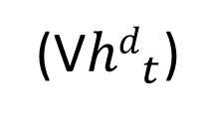
Decoder Basic Design
produce an output sequence an element at a time
Last hidden state of the encoder
z₁
z₂
First hidden state of the decoder
(V${hd}_{t}$)
Notes:
autoregressive generation is used to produce an output sequence,
an element at a time, until an end-of-sequence marker is generated
This incremental
process is guided by the context provided by the encoder as well as any items
generated for earlier states by the decoder.

Slide 14

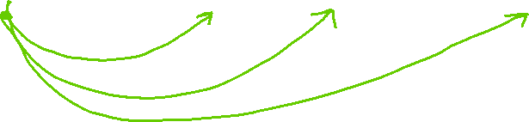
Decoder Design Enhancement
z₁
z₂
Context available at each step of decoding
Notes:
autoregressive generation is used to produce an output sequence,
an element at a time, until an end-of-sequence marker is generated
This incremental
process is guided by the context provided by the encoder as well as any items
generated for earlier states by the decoder.

Slide 15









Decoder: How output y is chosen
z₁
z₂
Sample soft-max distribution (OK for generating novel output, not OK for e.g. MT or Summ)
Most likely output (doesn’t guarantee individual choices being made make sense together)
For sequence labeling we used Viterbi – here not possible ☹
Notes:
independently choosing the argmax over a sequence is not a reliable way of arriving
at a good output since it doesn’t guarantee that the individual choices being made
make sense together and combine into a coherent whole
With sequence labeling we
addressed this with a CRF-layer over the output token types combined with a Viterbistyle
dynamic programming search. Unfortunately, this approach is not viable here
since the dynamic programming invariant doesn’t hold.

Slide 16











4 most likely “words” decoded from initial state
Feed each of those in decoder and keep most likely 4 sequences of two words
Feed most recent word in decoder and keep most likely 4 sequences of three words …….
When EOS is generated. Stop sequence and reduce Beam by 1
Notes:
Beam decoding with a beam width of 4. At the initial step, the frontier is filled with the best 4
options from the initial state of the decoder. In a breadth-first fashion, each state on the frontier is passed to a
decoder which computes a softmax over the entire vocabulary and attempts to enter each as a new state into the
frontier subject to the constraint that they are better than the worst state already there. As completed sequences
are discovered they are recorded and removed from the frontier and the beam width is reduced by 1.

Slide 17
Today Nov 4
Encoder Decoder
Attention
Transformers

Slide 18








Flexible context: Attention
Context vector c: function of h_{1:n} and conveys the essence of the input to the decoder.
Flexible?
Different for each h_{i}
Flexibly combining the h_{j}
h₂
h₁
h_{m}
h₁
h₂
h_{n}
Notes:
we’ll need a mechanism that can take the entire encoder context into account, that dynamically
updates during the course of decoding, and that can be embodied in a fixed-size
attention vector. Taken together, we’ll refer such an approach as an attention mechanism.

Slide 19





Attention (1): dynamically derived context
Replace static context vector with dynamic c_{i}
derived from the encoder hidden states at each point i during decoding
Ideas:
should be a linear combination of those states
should depend on ?
Notes:
Replace the static context vector with one that is dynamically derived from the encoder hidden states at each point during decoding

Slide 20









Attention (2): computing c_{i}
Compute a vector of scores that capture the relevance of each encoder hidden state to the decoder state
Just the similarity
Give network the ability to learn which aspects of similarity between the decoder and encoder states are important to the current application.
Notes:
The first step in computing ci is to compute a vector of scores that capture the
relevance of each encoder hidden state to the decoder state captured in hdi
For now, let’s assume that this score provides us with a measure of how similar
the decoder hidden state is to each encoder hidden state
By introducing Ws to the score, we are giving the network the ability to learn which
aspects of similarity between the decoder and encoder states are important to the
current application.

Slide 21









Attention (3): computing c_{i} From scores to weights
Create vector of weights by normalizing scores
Goal achieved: compute a fixed-length context vector for the current decoder state by taking a weighted average over all the encoder hidden states.
Notes:
To make use of these scores, we’ll next normalize them with a softmax to create
a vector of weights, ai j, that tells us the proportional relevance of each encoder
hidden state j to the current decoder state, i.
Finally, given the distribution in a, we can compute a fixed-length context vector for
the current decoder state by taking a weighted average over all the encoder hidden
states.

Slide 22




Attention: Summary
Decoder
Encoder
Notes:
To make use of these scores, we’ll next normalize them with a softmax to create
a vector of weights, ai j, that tells us the proportional relevance of each encoder
hidden state j to the current decoder state, i.

Slide 23





Explain Y. Goldberg different notation

Slide 24






























Intro to Encoder-Decoder and Attention (Goldberg’s notation)
Decoder
Encoder

Slide 25
Today Nov 4
Encoder Decoder
Attention
Transformers (self-attention)

Slide 26
Transformers (Attention is all you need 2017)
Just an introduction: These are two valuable resources to learn more details on the architecture and implementation
Also Assignment 4 will help you learn more about Transformers
http://nlp.seas.harvard.edu/2018/04/03/attention.html
https://jalammar.github.io/illustrated-transformer/ (slides come from this source)

Slide 27
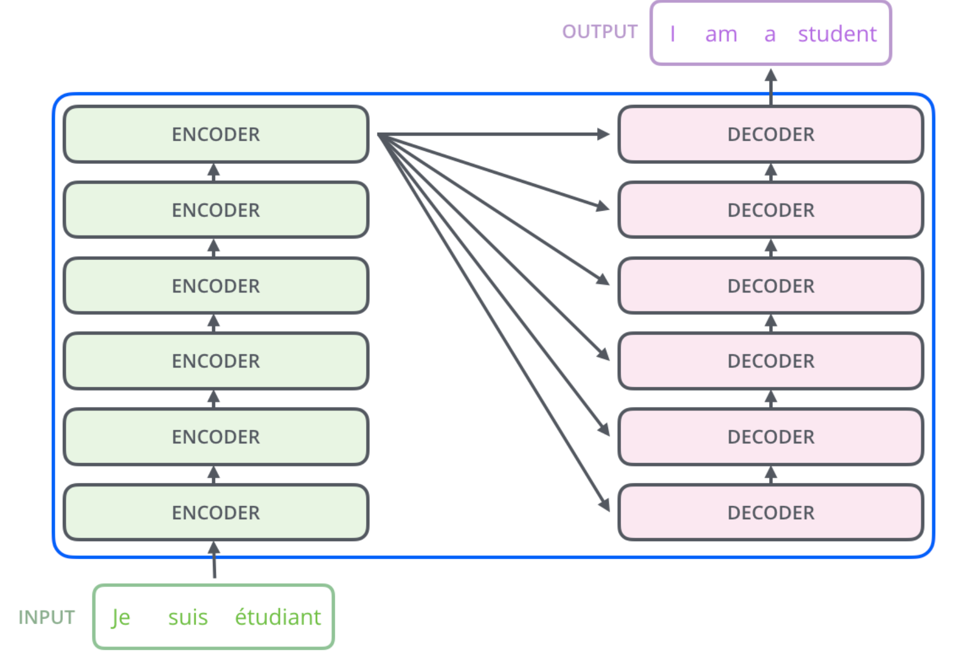
High-level architecture
Will only look at the ENCODER(s) part in detail

Slide 28
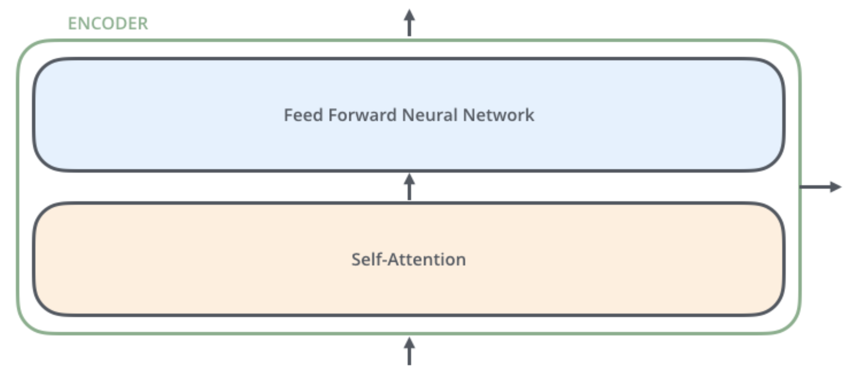
The encoders are all identical in structure (yet they do not share weights). Each one is broken down into two sub-layers
outputs of the self-attention are fed to a feed-forward neural network. The exact same one is independently applied to each position.
helps the encoder look at other words in the input sentence as it encodes a specific word.

Slide 29
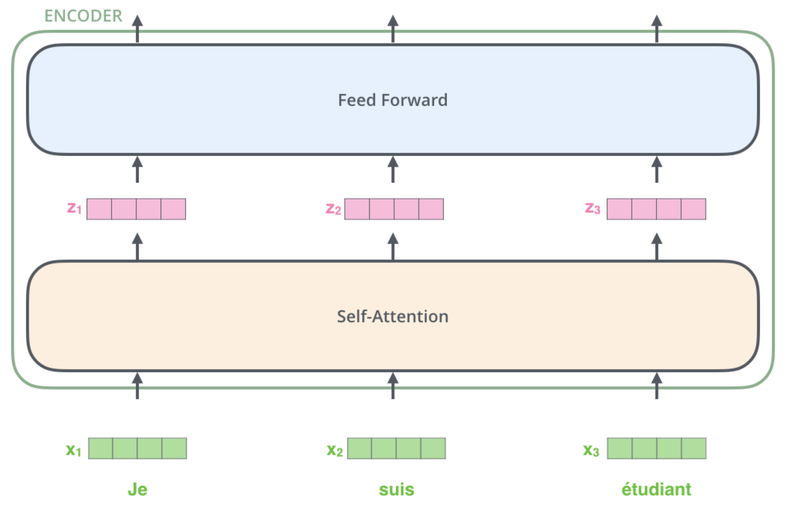
Key property of Transformer: word in each position flows through its own path in the encoder.
There are dependencies between these paths in the self-attention layer.
Feed-forward layer does not have those dependencies => various paths can be executed in parallel !
Word embeddings
Notes:
The size of this list is hyperparameter we can set – basically it would be the length of the longest sentence in our training dataset.
Here we begin to see one key property of the Transformer, which is that the word in each position flows through its own path in the encoder. There are dependencies between these paths in the self-attention layer. The feed-forward layer does not have those dependencies, however, and thus the various paths can be executed in parallel while flowing through the feed-forward layer.

Slide 30
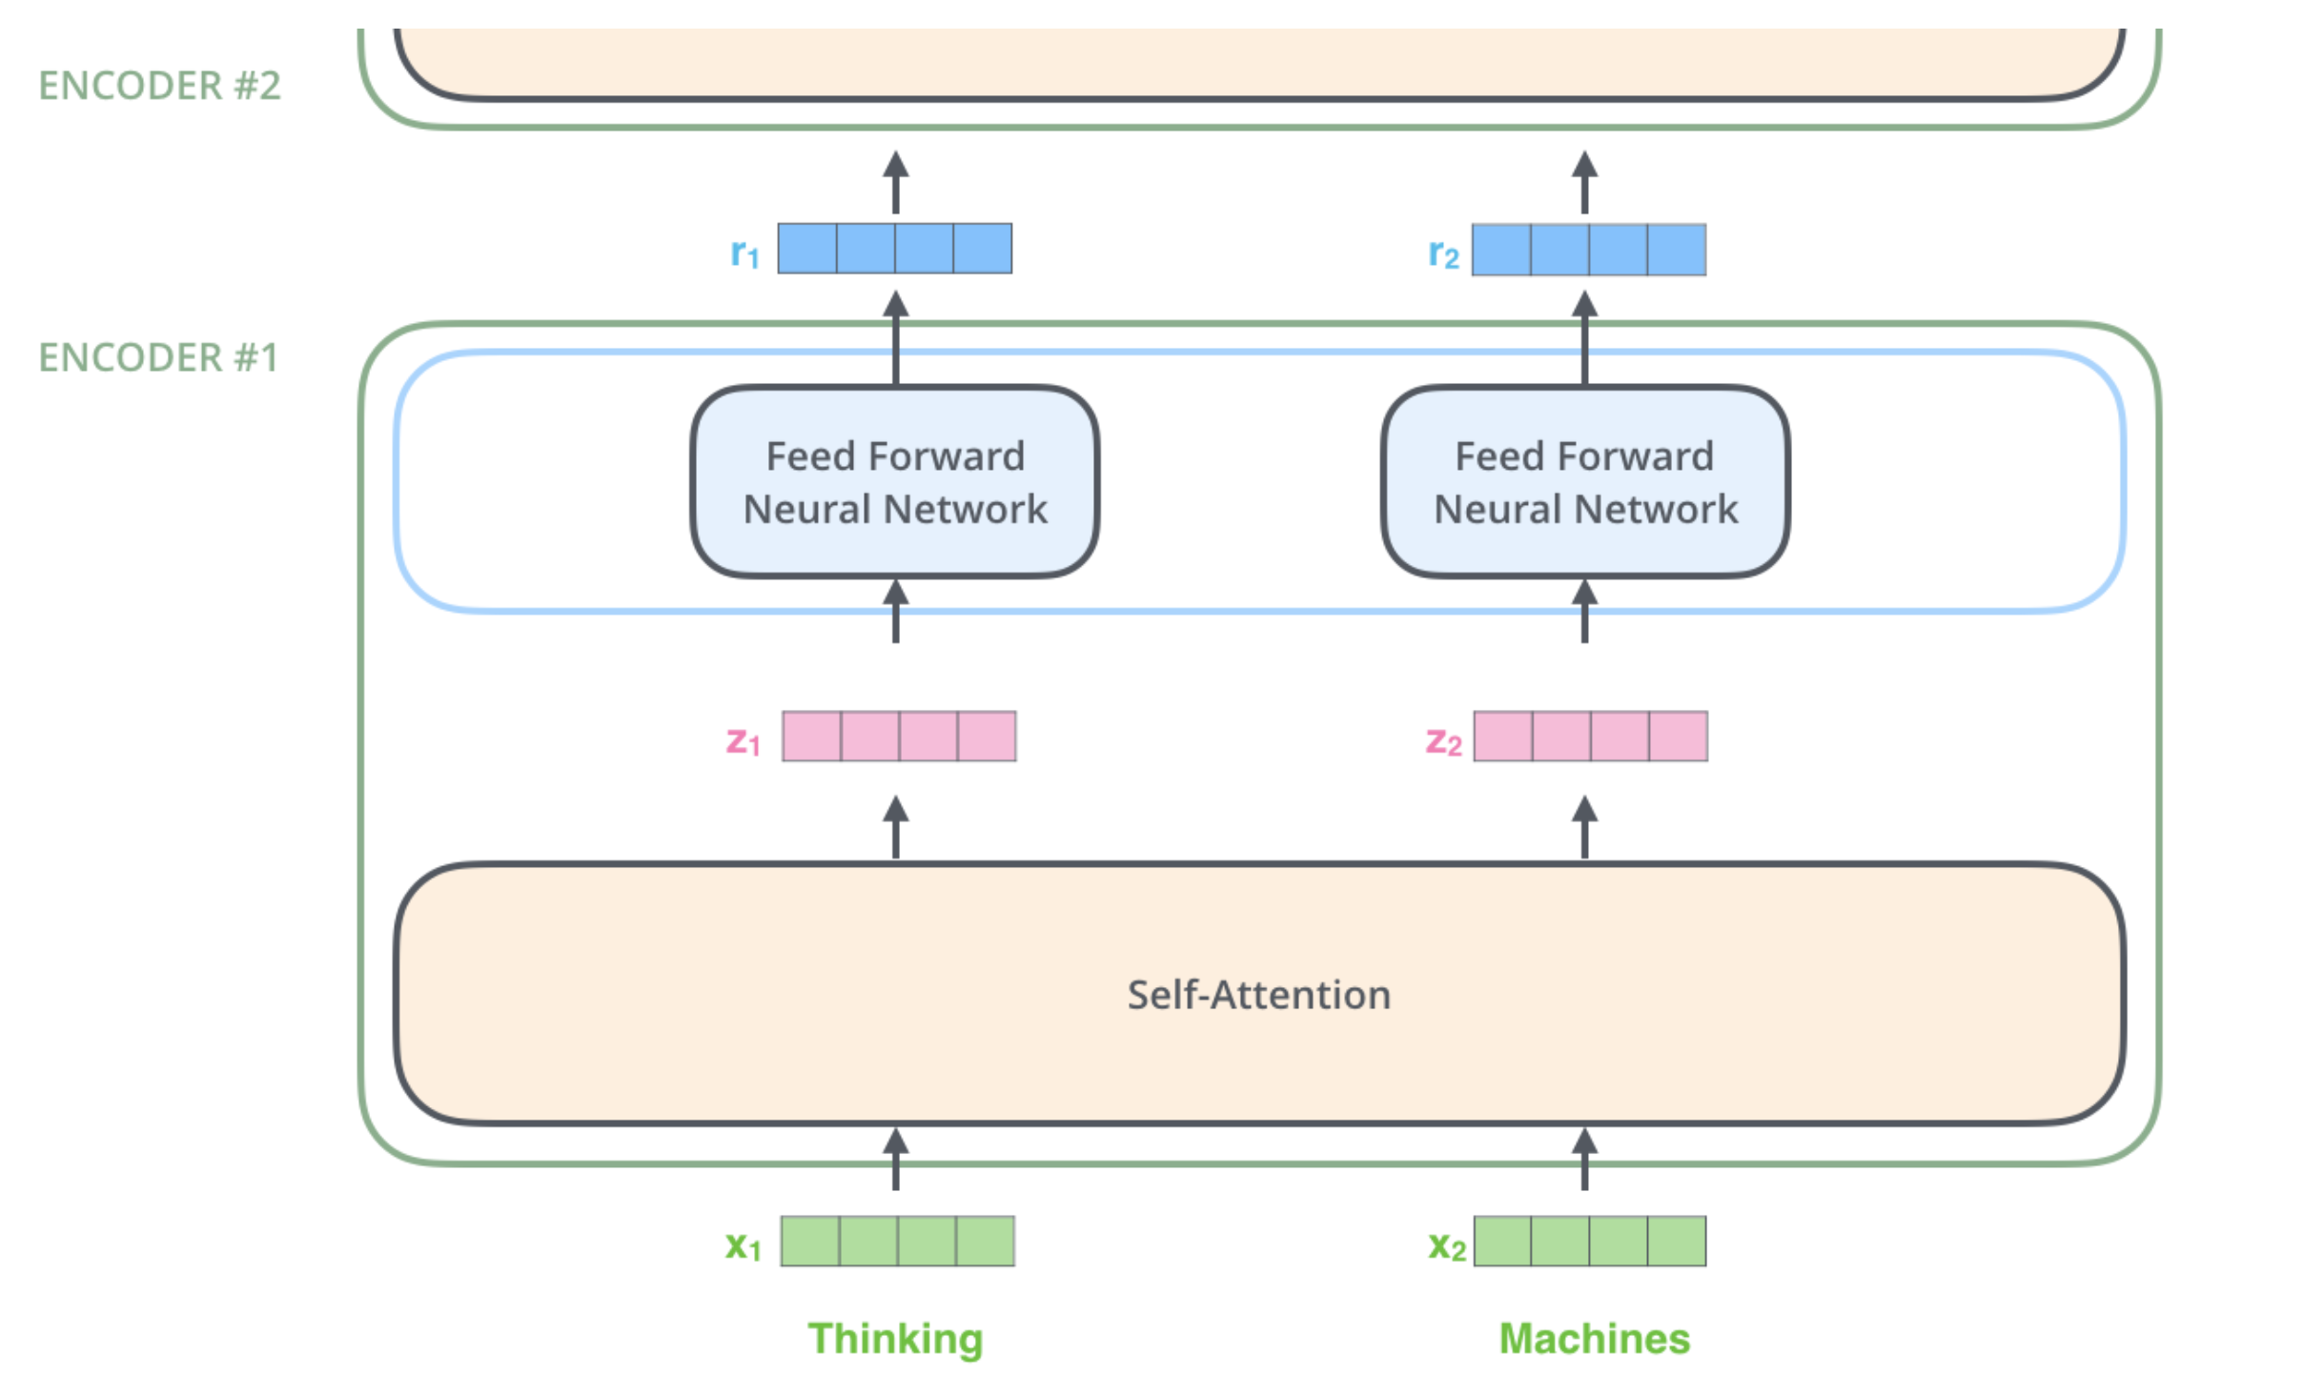


Visually clearer on two words
dependencies in self-attention layer.
No dependencies in Feed-forward layer
Word embeddings

Slide 31
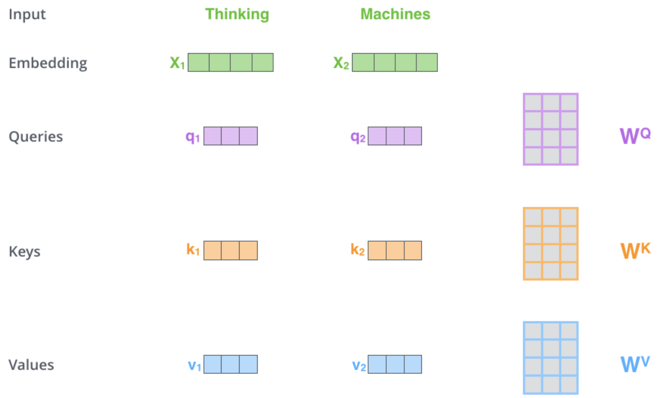
Self-Attention
While processing each word it allows to look at other positions in the input sequence for clues to build a better encoding for this word.
Step1: create three vectors from each of the encoder’s input vectors:
Query, a Key, Value (typically smaller dimension).
by multiplying the embedding by three matrices that we trained during the training process.
Notes:
As the model processes each word (each position in the input sequence), self attention allows it to look at other positions in the input sequence for clues that can help lead to a better encoding for this word.
If you’re familiar with RNNs, think of how maintaining a hidden state allows an RNN to incorporate its representation of previous words/vectors it has processed with the current one it’s processing. Self-attention is the method the Transformer uses to bake the “understanding” of other relevant words into the one we’re currently processing.
The first step in calculating self-attention is to create three vectors from each of the encoder’s input vectors (in this case, the embedding of each word). So for each word, we create a Query vector, a Key vector, and a Value vector. These vectors are created by multiplying the embedding by three matrices that we trained during the training process.
Notice that these new vectors are smaller in dimension than the embedding vector. Their dimensionality is 64, while the embedding and encoder input/output vectors have dimensionality of 512. They don’t HAVE to be smaller, this is an architecture choice to make the computation of multiheaded attention (mostly) constant.

Slide 32
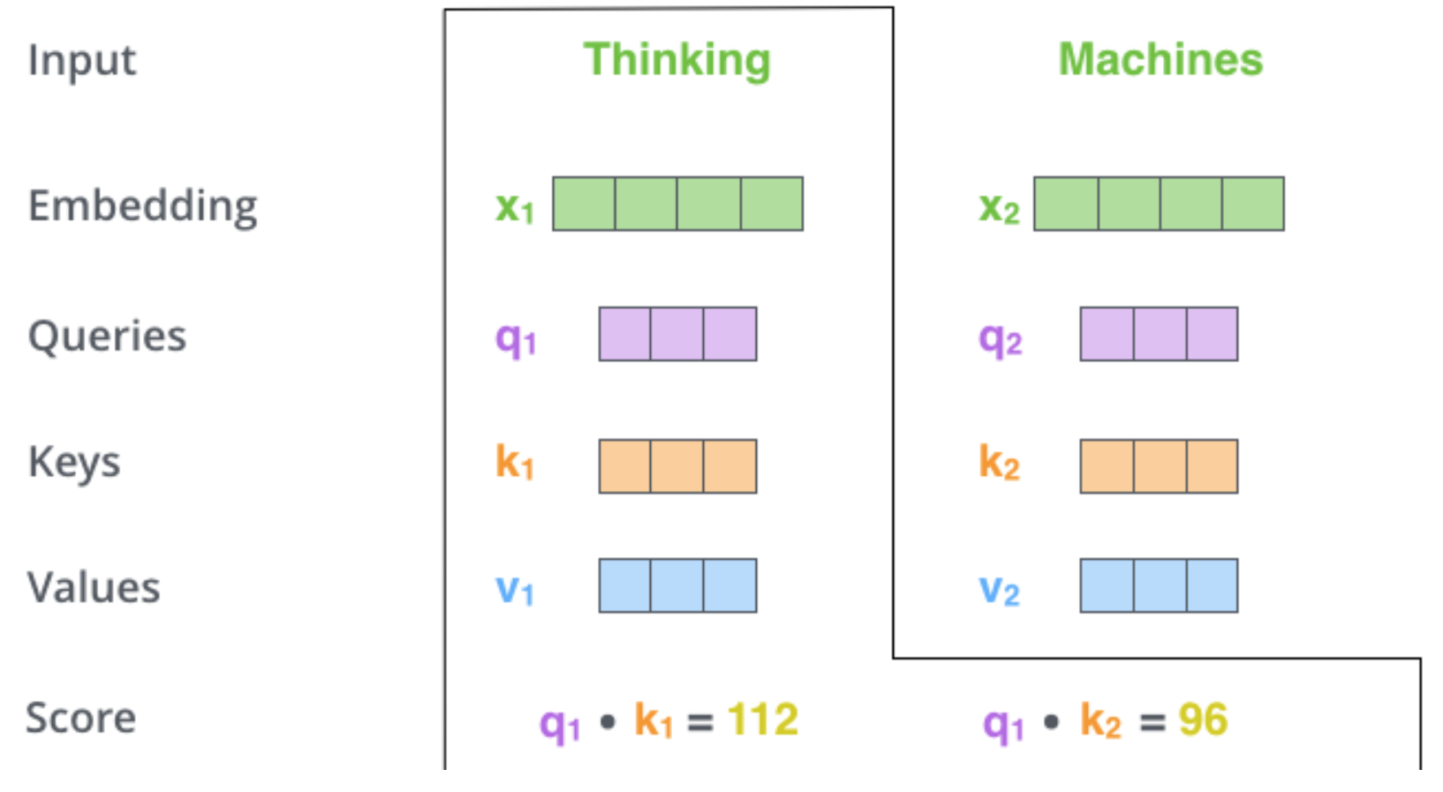
Self-Attention
Step 2: calculate a score (like we have seen for regular attention!) how much focus to place on other parts of the input sentence as we encode a word at a certain position.
Take dot product of the query vector with the key vector of the respective word we’re scoring.
E.g., Processing the self-attention for word “Thinking” in position #1, the first score would be the dot product of q1 and k1. The second score would be the dot product of q1 and k2.
Notes:
The second step in calculating self-attention is to calculate a score. Say we’re calculating the self-attention for the first word in this example, “Thinking”. We need to score each word of the input sentence against this word. The score determines how much focus to place on other parts of the input sentence as we encode a word at a certain position.
The score is calculated by taking the dot product of the query vector with the key vector of the respective word we’re scoring. So if we’re processing the self-attention for the word in position #1, the first score would be the dot product of q1 and k1. The second score would be the dot product of q1 and k2.

Slide 33
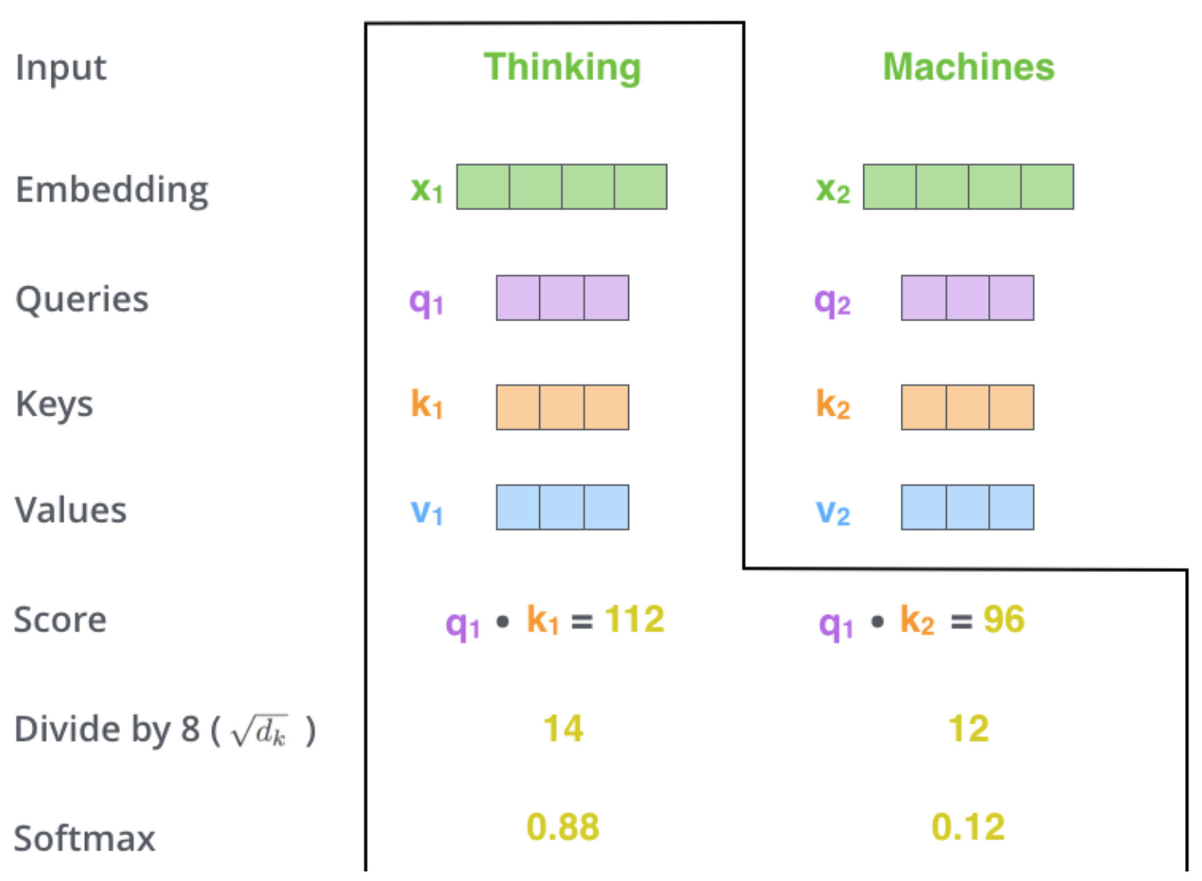




Self Attention
Step 3 divide scores by the square root of the dimension of the key vectors (more stable gradients).
Step 4 pass result through a softmax operation. (all positive and add up to 1)
Intuition: softmax score determines how much each word will be expressed at this position.
Notes:
The third and forth steps are to divide the scores by 8 (the square root of the dimension of the key vectors used in the paper – 64. This leads to having more stable gradients. There could be other possible values here, but this is the default), then pass the result through a softmax operation. Softmax normalizes the scores so they’re all positive and add up to 1

Slide 34
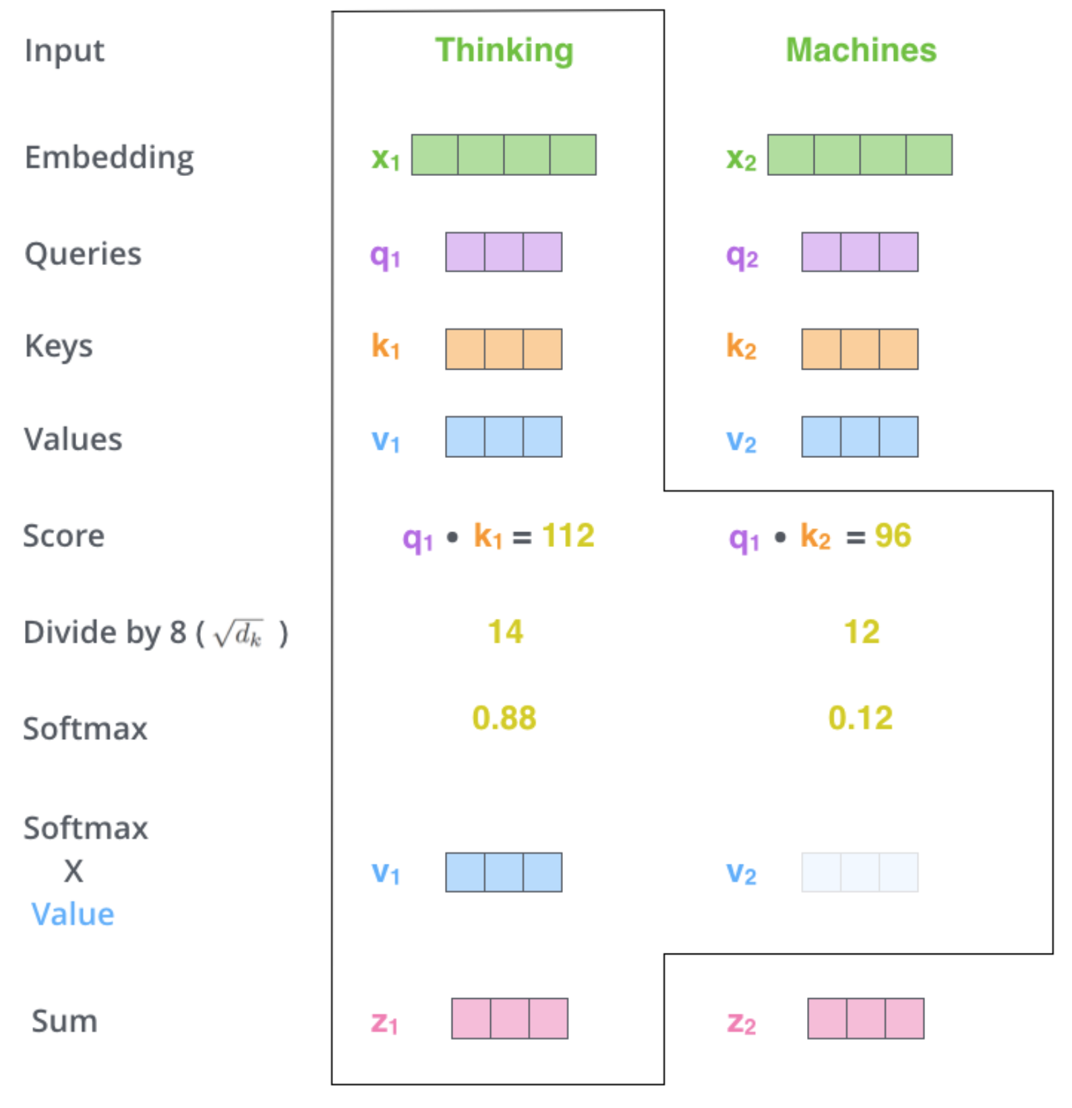
Self Attention
Step6 : sum up the weighted value vectors. This produces the output of the self-attention layer at this position
More details:
What we have seen for a word is done for all words (using matrices)
Need to encode position of words
And improved using a mechanism called “multi-headed” attention
(kind of like multiple filters for CNN)
see https://jalammar.github.io/illustrated-transformer/
Notes:
The third and forth steps are to divide the scores by 8 (the square root of the dimension of the key vectors used in the paper – 64. This leads to having more stable gradients. There could be other possible values here, but this is the default), then pass the result through a softmax operation. Softmax normalizes the scores so they’re all positive and add up to 1

Slide 35
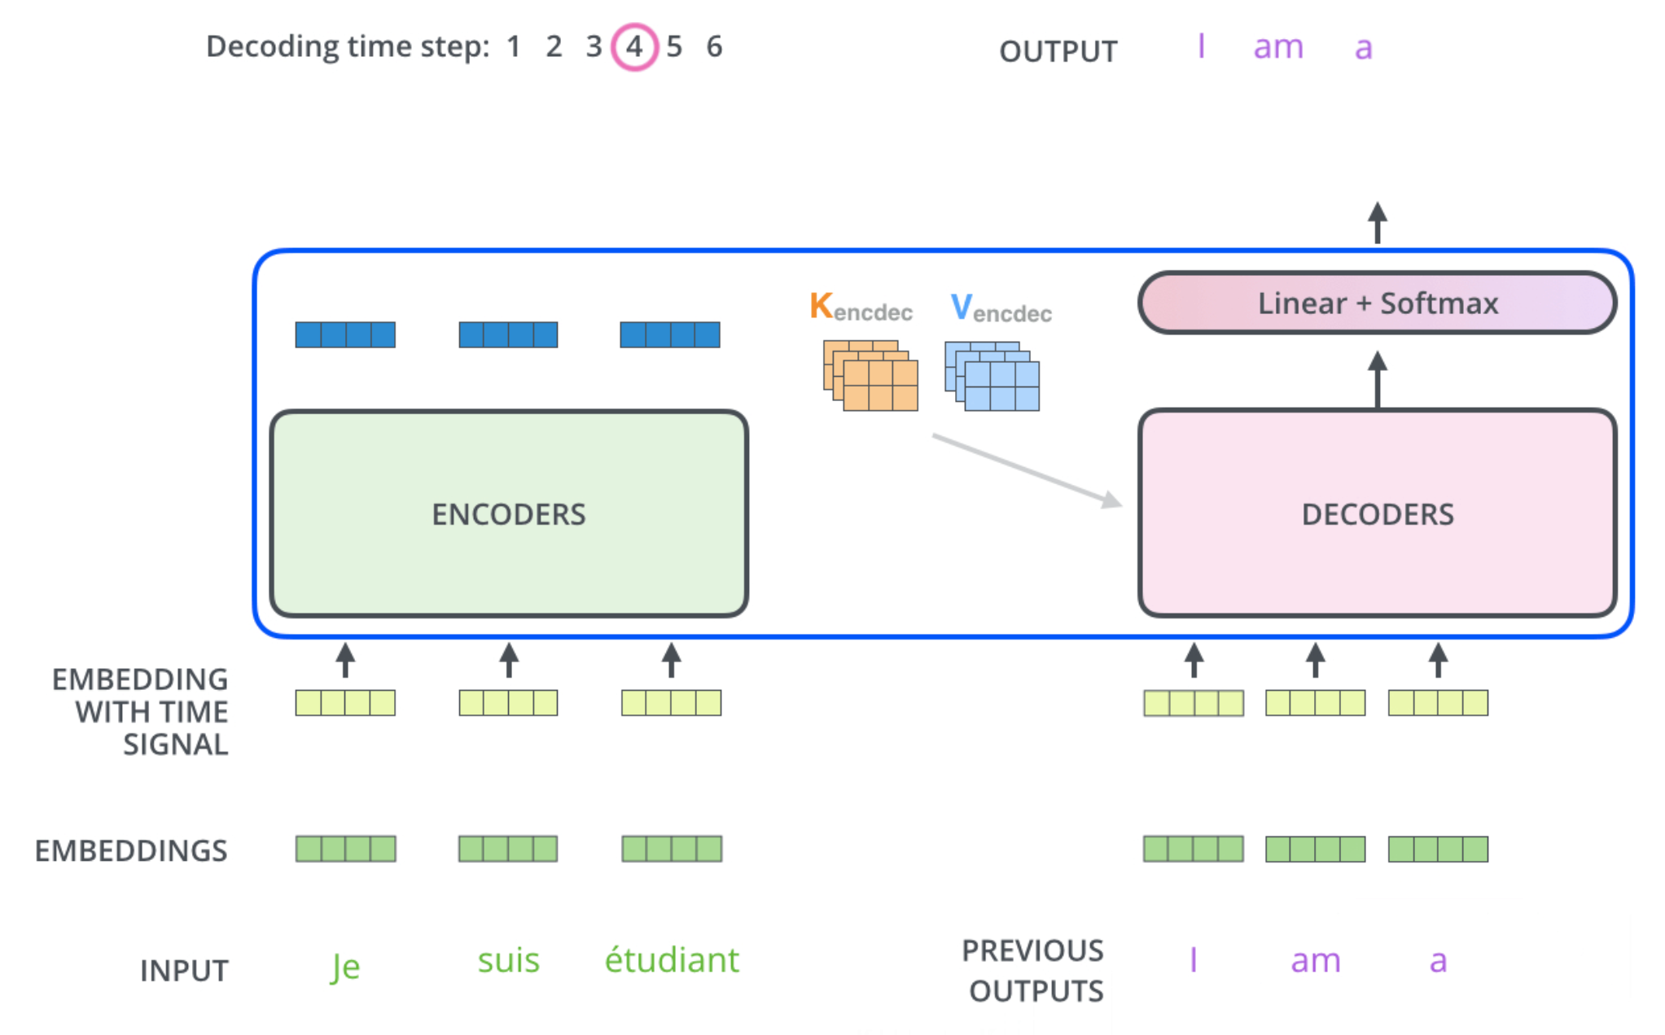
The Decoder Side
Relies on most of the concepts on the encoder side
See animation on https://jalammar.github.io/illustrated-transformer/

Slide 36
Next class: Mon Nov. 9
Read carefully!
Assignment-4 out tonight
Due Nov 13
Will send out two G-Forms
On title and possibly group composition of the project (fill out by Friday)
On your preferences for which paper to present
Project proposal (submit your write-up and copy of your slides on Canvas; Write-up: 1-2 pages single project, 3-4 pages for group project)
Project proposal Presentation
Approx. 3.5 min presentation + 1.5 min for questions (8 tot. mins if you are in a group)
For content, follow instructions at course project web page
Please have your presentation ready on your laptop to minimize transition delays
We will start in the usual zoom room @noon (sharp)

Slide 37
Today March 11
Encoder Decoder
Attention
Transformers
Very Brief Intro Pragmatics

Slide 38
Pragmatics: Example
(i) A: So can you please come over here again right now
(ii) B: Well, I have to go to Edinburgh today sir
(iii) A: Hmm. How about this Thursday?
What information can we infer about the context in which this (short and insignificant) exchange occurred ?
we can make a great number of detailed (Pragmatic) inferences about the nature of the context in which it occurred
Notes:
It is not difficult to see that in understanding such an exchange we make a great
number of detailed (Pragmatic) inferences about the nature of the context in which it occured
This will serve to clarify the general nature of the phenomena pragmatics is concerned with

Slide 39
Pragmatics: Conversational Structure
(i) A: So can you please come over here again right now
(ii) B: Well, I have to go to Edinburgh today sir
(iii) A: Hmm. How about this Thursday?
Not the end of a conversation (nor the beginning)
Pragmatic knowledge: Strong expectations about the structure of conversations
Pairs e.g., request <-> response
Closing/Opening forms

Slide 40
Pragmatics: Dialog Acts
Not a Y/N info seeking question like “can you run for 1h?”
It is a request for an action
(i) A: So can you please come over here again right now?
(ii) B: Well, I have to go to Edinburgh today sir
(iii) A: Hmm. How about this Thursday?
A is requesting B to come at time of speaking,
B implies he can’t (or would rather not)
A repeats the request for some other time.
Pragmatic assumptions relying on:
mutual knowledge (B knows that A knows that…)
co-operation (must be a response… triggers inference)
topical coherence (who should do what on Thur?)
Notes:
The first utterance is not a Y/N question (like “can you run for more than 1 hour)
It would be strikingly uncooperative if B were to say yes (meaning just ‘yes I am able to come’)
B knows that A knows that B is capable to go there

Slide 41
Pragmatics: Specific Act (Request)
(i) A: So can you please come over here again right now
(ii) B: Well, I have to go to Edinburgh today sir
(iii) A: Hmm. How about this Thursday?
A wants B to come over
A believes it is possible for B to come over
A believes B is not already there
A believes he is not in a position to order B to…
Pragmatic knowledge: speaker beliefs and intentions underlying the act of requesting
Assumption: A behaving rationally and sincerely
Notes:
In requesting A ….. It is possible for B to come, thinks B is not already there, B was not about to come anyway…

Slide 42
Pragmatics: Deixis
(i) A: So can you please come over here again right now
(ii) B: Well, I have to go to Edinburgh today sir
(iii) A: Hmm. How about this Thursday?
A assumes B knows where A is
Neither A nor B are in Edinburgh
The day in which the exchange is taking place is not Thur., nor Wed. (or at least, so A believes)
Pragmatic knowledge: References to space and time wrt space and time of speaking
Notes:
Reference to space and time with respect to space and time of speaking (context)
Come, go, here and now

Slide 43
Additional Notes (not required)

Slide 44
From Yoav Artzi (these are links)
 | Contextualized word representations |  | Annotated Transformer, Illustrated Transformer, ELMo, BERT, The Illustrated BERT, ELMo, and co.

Slide 45
Transformers
WIKIPEDIA:
However, unlike RNNs, Transformers do not require that the sequence be processed in order. So, if the data in question is natural language, the Transformer does not need to process the beginning of a sentence before it processes the end. Due to this feature, the Transformer allows for much more parallelization than RNNs during training.^{[1]}

Slide 46
The Transformer uses multi-head attention in three different ways:
In "encoder-decoder attention" layers, the queries come from the previous decoder layer,
and the memory keys and values come from the output of the encoder. This allows every
position in the decoder to attend over all positions in the input sequence. This mimics the
typical encoder-decoder attention mechanisms in sequence-to-sequence models such as
[38, 2, 9].
The encoder contains self-attention layers. In a self-attention layer all of the keys, values
and queries come from the same place, in this case, the output of the previous layer in the
encoder. Each position in the encoder can attend to all positions in the previous layer of the
encoder.
Similarly, self-attention layers in the decoder allow each position in the decoder to attend to
all positions in the decoder up to and including that position. We need to prevent leftward
information flow in the decoder to preserve the auto-regressive property. We implement this
inside of scaled dot-product attention by masking out (setting to infinity) all values in the input
of the softmax which correspond to illegal connections. See Figure 2.
At each step the model is auto-regressive
[10], consuming the previously generated symbols as additional input when generating the next.
The autoregressive model specifies that the output variable depends linearly on its own previous values and on a stochastic term (an imperfectly predictable term);
Notes:
The autoregressive model specifies that the output variable depends linearly on its own previous values and on a stochastic term (an imperfectly predictable term);

Slide 47
An attention function can be described as mapping a query and a set of key-value pairs to an output, where the query, keys, values, and output are all vectors. The output is computed as a weighted sum of the values, where the weight assigned to each value is computed by a compatibility function of the query with the corresponding key.

Slide 48
Positional Encodings
In geometry, an affine transformation, affine map^{[1]} or an affinity (from the Latin, affinis, "connected with") is a function between affine spaces which preserves points, straight lines and planes. Also, sets of parallel lines remain parallel after an affine transformation. An affine transformation does not necessarily preserve angles between lines or distances between points, though it does preserve ratios of distances between points lying on a straight line.

Slide 49
Additional resources !
References/Resources to explain transformers in cpsc503. And possible question for assignment
http://jalammar.github.io/illustrated-transformer/
Combined with this http://nlp.seas.harvard.edu/2018/04/03/attention.html
Medium article that I read a while back and thought that s a nice intro to the transformer: https://medium.com/@adityathiruvengadam/transformer-architecture-attention-is-all-you-need-aeccd9f50d09
They first start with motivating attention in general and show problems of RNN/CNN architectures, then leading to the transformer. I especially liked some of the visualizations they have. But it is a relatively long read and unfortunately, at some points, it's not super consistent.
I thought it might be still useful.

Slide 50
